Slide 1
Weekly Report
Wensheng Cheng
2022.1.18-1.24

Slide 2
Last discussion
Train an oracle detector with the ground truth label on the 1st image of each sequence
Run SOTA data association methods on our task
Concerns

Slide 3
This week
Experiments on why oracle detector performs worse than the detector trained with baseline result on the first image, without instance NMS post processing
Experiments on the effectiveness of instance NMS with different detection thresholds used in the data association stage
More experimental results on few shot counting
Directions, matching based or semi supervised

Slide 4
Correction-SOTA Data Association Method
 | Instance NMS th=0.5+byte | Instance NMS th=0.5 | Instance NMS th=0.5-gt+byte | Instance NMS th=0.5-gt
MOTA | 34.8% | 20.8% | 51.5% | 37.7%
MOTP low | 0.266 (have NaN seq) | 0.260 | 0.253 | 0.242
IDs low | 1745 | 5789 | 21173(change to 2797) | 6298
IDF1 | 49.3% | 37.8% | 63.3% | 49.2%
IDP | 67.0% | 41.0% | 64.9% | 47.3%
IDR | 39.0% | 35.0% | 61.7% | 51.1%
Rcll | 46.8% | 54.2% | 73.8% | 74.1%
Pron | 80.6% | 63.5% | 77.7% | 68.6%
FP low | 28895 | 79951 | 54347 | 87128
FN low | 136304 | 117305 | 67101 | 66353

Slide 5
Baseline Detector vs. Det Thresholds
For baseline detection results, remove detection results with confidence lower than thresholds, and do a simple data association.
No post process | det_th=0.1 | 0.3 | 0.5 | 0.7 | 0.9
MOTA | -90.4% | 8.4% | 26.5% | 14.7% | 0.3%
MOTP low | 0.272(1 NaN) | 0.261(4 NaN) | 0.247(5 NaN) | 0.230(12 NaN) | 0.255(33 NaN)
IDs low | 16853 | 9784 | 4390 | 1487 | 85
IDF1 | 17.6% | 26.7% | 29.1% | 18.7% | 0.5%
IDP | 13.0% | 28.7% | 50.2% | 62.0% | 44.3%
IDR | 27.2% | 25.0% | 20.5% | 11.0% | 0.3%
Rcll | 62.6% | 49.6% | 34.5% | 16.5% | 0.5%
Pron | 30.0% | 57.0% | 84.5% | 93.0% | 82.2%
FP low | 375552 | 95940 | 16189 | 3181 | 267
FN low | 95768 | 129094 | 167895 | 214072 | 255104

Slide 6
Baseline Detector vs. Det Thresholds
For baseline detection results, remove detection results with confidence lower than thresholds, use post process and then do a simple data association.
inst_th_05_op_2 | det_th=0.1 | 0.3 | 0.5 | 0.7 | 0.9
MOTA | 29.2% | 34.2% | 28.2% | 14.7% | 0.3%
MOTP low | 0.259(1 NaN) | 0.253(4 NaN) | 0.245(5 NaN) | 0.230(12 NaN) | 0.255(33 NaN)
IDs low | 5490 | 4129 | 3255 | 1457 | 85
IDF1 | 39.4% | 39.5% | 32.5% | 18.7% | 0.5%
IDP | 46.6% | 56.8% | 59.7% | 62.3% | 44.3%
IDR | 34.2% | 30.3% | 22.3% | 11.0% | 0.3%
Rcll | 52.3% | 44.6% | 33.5% | 16.5% | 0.5%
Pron | 71.4% | 83.5% | 89.4% | 93.1% | 82.2%
FP low | 53850 | 22506 | 10147 | 3123 | 267
FN low | 122200 | 142037 | 170556 | 214145 | 255104

Slide 7
GT Detector vs. Det Thresholds
For oracle detection results, remove detection results with confidence lower than thresholds, and do a simple data association.
No post process | det_th=0.1 | 0.3 | 0.5 | 0.7 | 0.9
MOTA | -128.7% | 12.1% | 46.0% | 25.6% | 1.8%
MOTP low | 0.254(0 NaN) | 0.248(0 NaN) | 0.229(0 NaN) | 0.206(9 NaN) | 0.163(31 NaN)
IDs low | 20983 | 15170 | 6684 | 2474 | 173
IDF1 | 18.9% | 31.6% | 40.6% | 28.0% | 2.3%
IDP | 12.7% | 27.0% | 50.6% | 61.2% | 63.0%
IDR | 37.0% | 38.1% | 33.9% | 18.1% | 1.2%
Rcll | 85.4% | 79.5% | 57.8% | 28.1% | 1.8%
Pron | 29.3% | 56.4% | 86.3% | 94.9% | 99.8%
FP low | 527800 | 157540 | 23572 | 3894 | 8
FN low | 37536 | 52520 | 108251 | 184277 | 251616

Slide 8
GT Detector vs. Det Thresholds
For oracle detection results, remove detection results with confidence lower than thresholds, use post process and then do simple data association.
inst_th_05_op_2 | det_th=0.1 | 0.3 | 0.5 | 0.7 | 0.9
MOTA | 41.0% | 55.9% | 49.6% | 25.6% | 1.8%
MOTP low | 0.242(0 NaN) | 0.239(0 NaN) | 0.227(0 NaN) | 0.205(9 NaN) | 0.255(31 NaN)
IDs low | 6289 | 5873 | 5036 | 2395 | 173
IDF1 | 49.9% | 53.6% | 47.6% | 28.6% | 2.3%
IDP | 48.8% | 58.2% | 62.7% | 62.9% | 63.0%
IDR | 51.1% | 49.6% | 38.4% | 18.5% | 1.2%
Rcll | 74.1% | 71.7% | 56.3% | 28.0% | 1.8%
Pron | 70.7% | 84.1% | 92.2% | 95.1% | 99.8%
FP low | 78647 | 34675 | 12258 | 3706 | 8
FN low | 66417 | 72607 | 111893 | 184551 | 251616

Slide 9
Use SOTA ByteTrack Association
We then combine the detection results after post processing with SOTA ByteTrack method to get tracklets.
baseline+ inst_th_05_op_2 | det_th_01+byte-track_th_015_min_det_001_det_th_025_match_th_090 | det_th_03+byte-track_th_040_min_det_001_det_th_040_match_th_090
MOTA | 34.8% | 34.0%
MOTP low | 0.266(2 NaN) | 0.262(5 NaN seq)
IDs low | 1810 | 1558
IDF1 | 49.2% | 46.7%
IDP | 67.1% | 71.3%
IDR | 38.9% | 34.7%
Rcll | 46.7% | 41.7%
Pron | 80.6% | 85.6%
FP low | 28766 | 18021
FN low | 136507 | 149488
gt+ inst_th_05_op_2 | det_th_01+byte-track_th_015_min_det_001_det_th_025_match_th_090 | det_th_03+byte-track_th_040_min_det_001_det_th_040_match_th_090
MOTA | 53.6% | 57.0%
MOTP low | 0.251(0 NaN) | 0.246(0 NaN)
IDs low | 3342 | 2999
IDF1 | 63.1% | 63.4%
IDP | 66.6% | 71.7%
IDR | 60.0% | 56.8%
Rcll | 72.5% | 68.6%
Pron | 80.5% | 86.7%
FP low | 44987 | 26902
FN low | 70515 | 80420

Slide 10
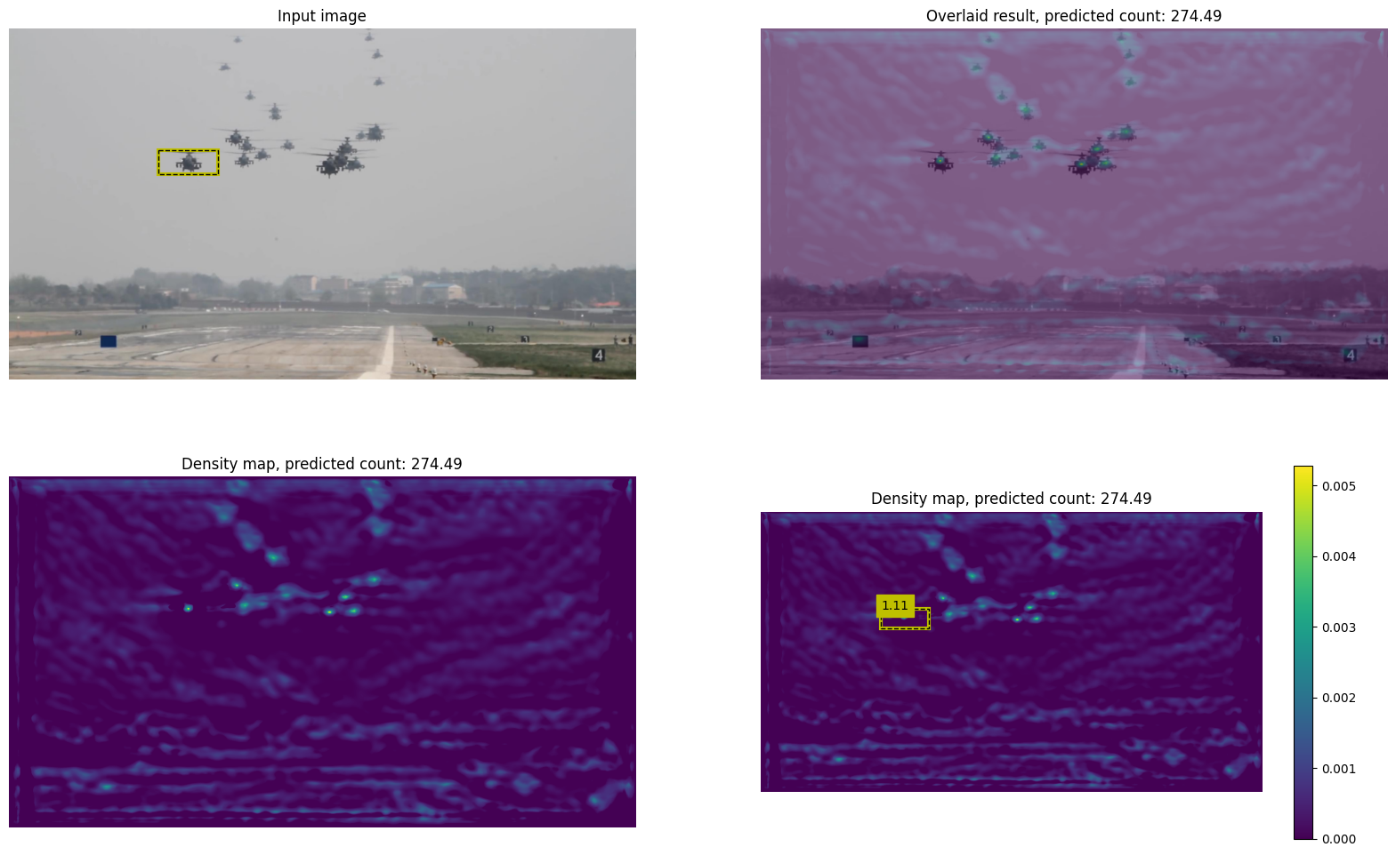
Few Shot Counting Results
We then test few shot counting method on all 40 sequences.
CVPR 2021. Learn To Count Everything.

Slide 11
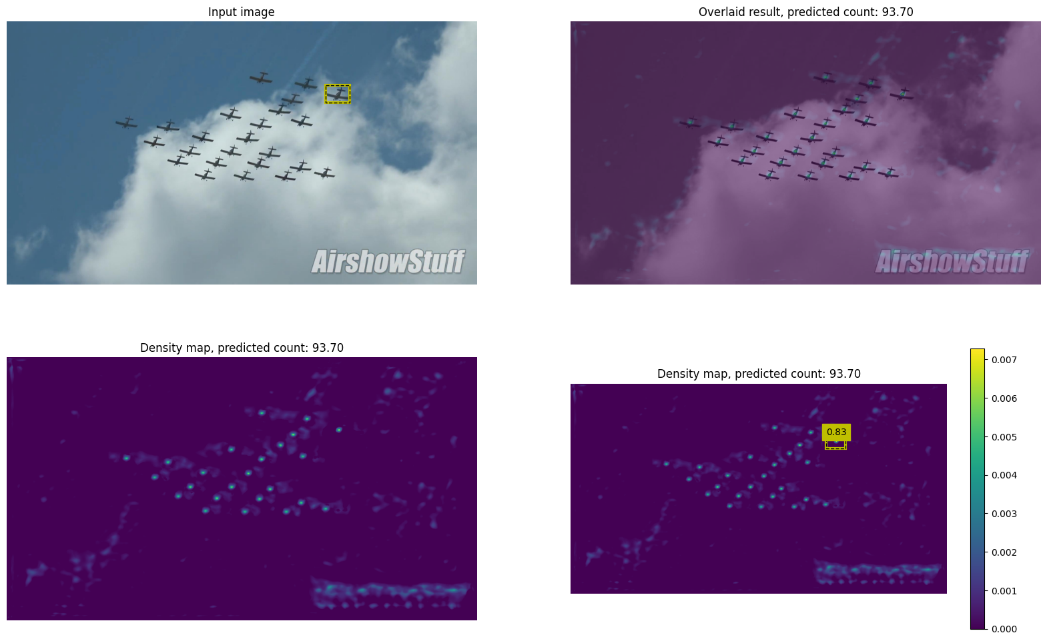
Few Shot Counting Results
We then test few shot counting method on all 40 sequences.
CVPR 2021. Learn To Count Everything.

Slide 12
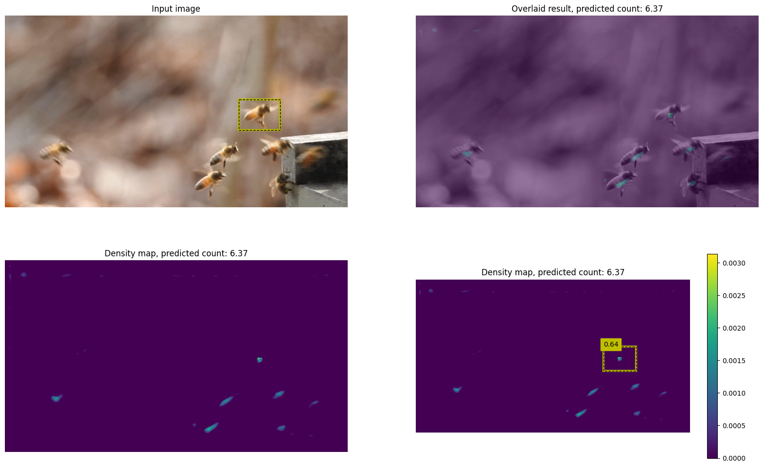
Few Shot Counting Results
We then test few shot counting method on all 40 sequences.
CVPR 2021. Learn To Count Everything.

Slide 13
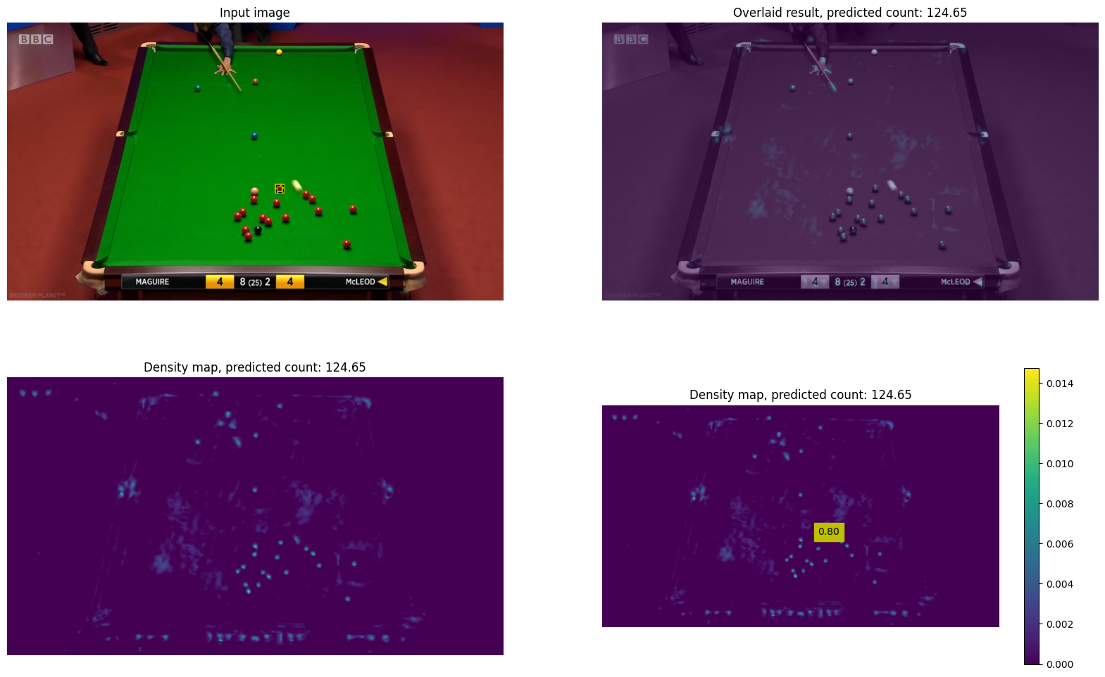
Few Shot Counting Results
We then test few shot counting method on all 40 sequences.
CVPR 2021. Learn To Count Everything.

Slide 14
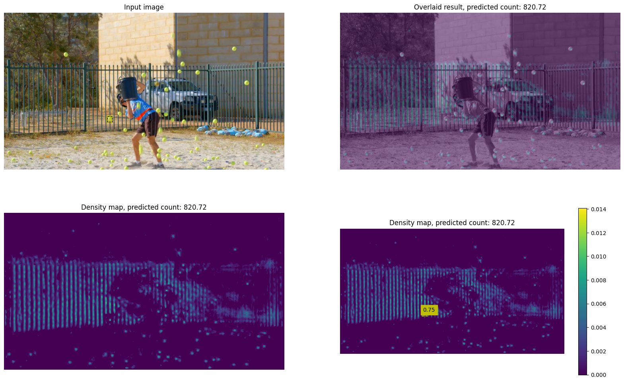
Few Shot Counting Results
We then test few shot counting method on all 40 sequences.
CVPR 2021. Learn To Count Everything.

Slide 15
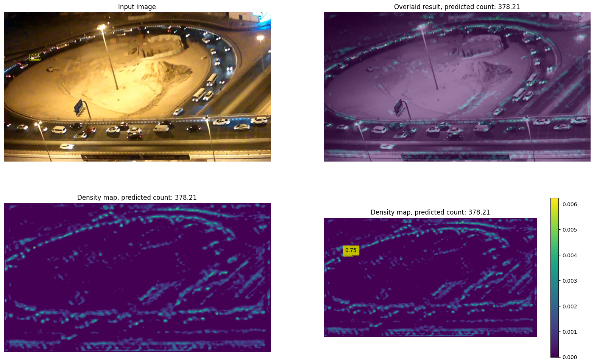
Few Shot Counting Results
We then test few shot counting method on all 40 sequences.
CVPR 2021. Learn To Count Everything.

Slide 16
Directions
Matching based: Few shot counting, few shot object detection, Siamese-like single object tracking, these methods need large labeled dataset to train the matching/feature extraction module.
Semi-supervised: take is as a semi-supervised task, with incomplete detection label, this doesn’t need extra large data, but the key is to filter unreliable detection results, saying we use the iterative training method.

Slide 17
End
End and Thanks!

